Slide 1
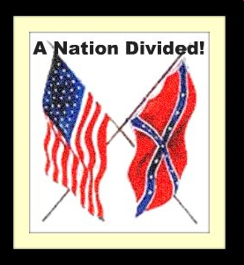
Texans Go to War

Slide 2
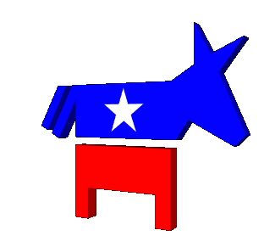
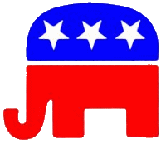
Political Divide
The Democrats were the dominant political party, and had very little competition from the Whig party.
-Texans would vote for southern democrats until the 1980’s!
Sam Houston, though he never joined the party, supported the Know-Nothing party which opposed immigration to the United States.
1854 Northerners created the Republican Party to stop the expansion of slavery.
Southerners saw the Republican party as a threat and talk of secession increased. (The act of a state withdrawing from the Union)
Lincoln was a Republican

Slide 3
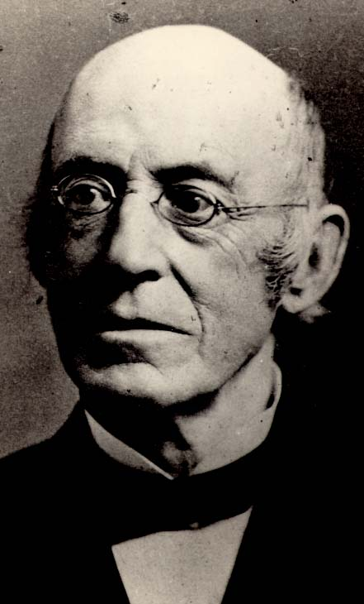
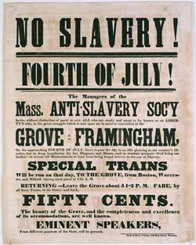
Abolitionist movement
Beginning in the 1750s, there was a widespread movement after the American Revolution that believed slavery was a social evil and should eventually be abolished.
After 1830, a religious movement led by William Lloyd Garrison declared slavery to be a personal sin and demanded the owners repent immediately and start the process of emancipation. (Granting Freedom to slaves)
An Abolitionist is someone who wanted to abolish slavery
William Lloyd Garrison

Slide 4
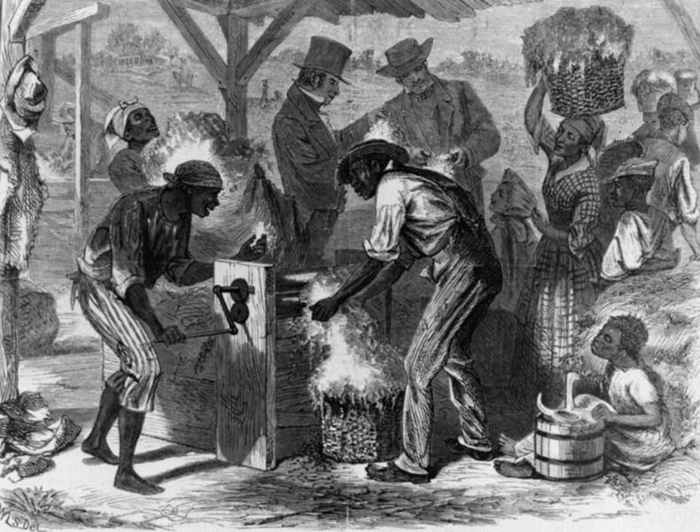
Slavery in the South
In 1793 with the invention of the cotton gin by Eli Whitney, the south saw an explosive growth in the cotton industry and this greatly increased demand for slave labor in the South.
Southern Christians believed that the Bible allows slavery and that it was acceptable for Christians to own slaves.
They also believed that the white man was superior to all other races and had been chosen by God to rule the earth.
Slaves working
on a cotton gin

Slide 5
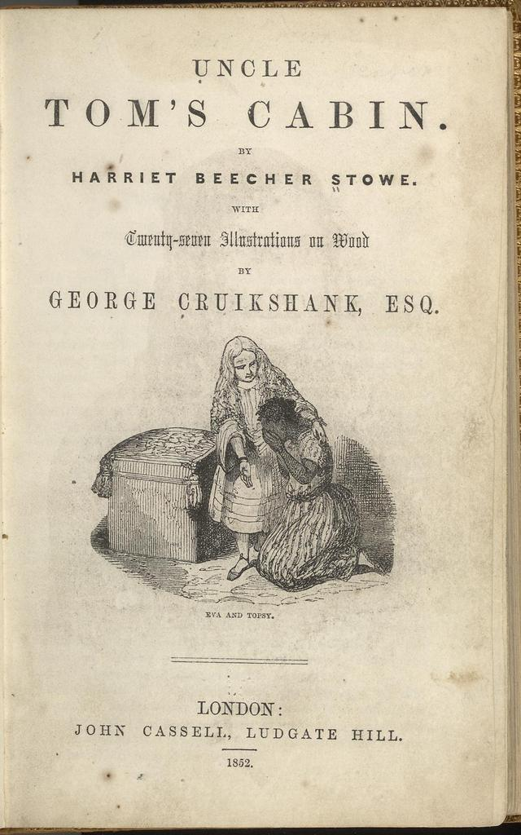
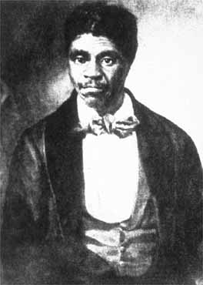
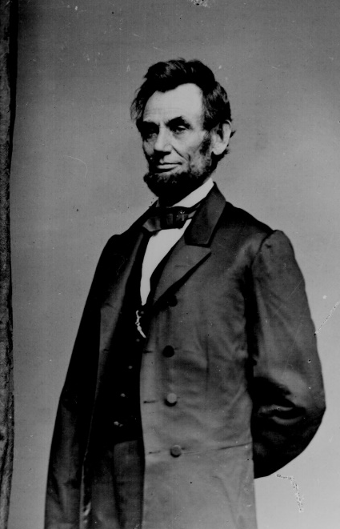
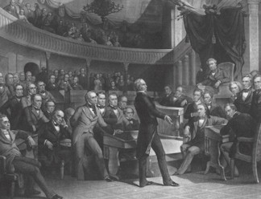
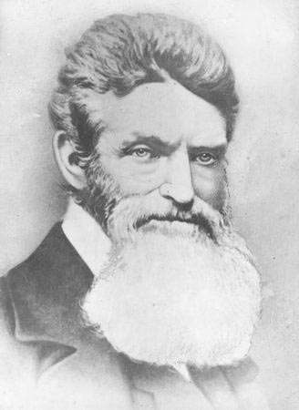
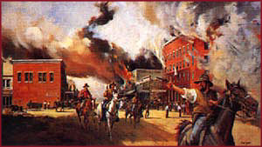
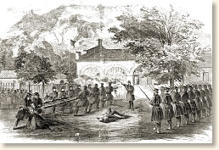
Each of these images represents something that contributed to the outbreak of the Civil War. What do you think they represent?
Notes:
ENGAGE: DETERMINE IF THE IMAGE REPRESENTS A POLITICAL, ECONOMIC OR SOCIAL REASON FOR THE WAR.

Slide 6
Road to Civil War
1850
1851
1852
1853
1854
1855
1856
1857
1858
1859
1860
Notes:
EXPLORE: STUDENTS WILL IDENTIFY 6 KEY EVENTS THAT OCCURRED BETWEEN 1850 AND 1860 THAT CONTRIBUTED TO THE OUTBREAK OF THE CIVIL WAR USING PAGE 373 AND 374 IN THE TEXAS HISTORY BOOK.
TEXAS! TE
Page 373
Compromise of 1850
Uncle Tom’s Cabin
Kansas-Nebraska Act
Dred Scott decision
John Brown’s raid
Page 374
Election of Lincoln

Slide 7
Road to Civil War
1850
1851
1852
1853
1854
1855
1856
1857
1858
1859
1860
Congress passes the Kansas-Nebraska Act allowing territories to decide on slavery
John Brown’s raid on Harpers Ferry, VA
Congress passes Compromise of 1850
California becomes a free state and the Fugitive Slave Act is passed
Supreme Court issues the Dred Scott v. Sanford decision
Republican Abraham Lincoln is elected president
Harriet Beecher Stowe’s book
Uncle Tom’s Cabin is published
Notes:
COMPROMISE OF 1850: created a way for new territories to become states, included new FUGITIVE SLAVE LAW (made it a crime to assist runaway slaves)
UNCLE TOM’S CABIN: anti-slavery novel greatly increased support for the abolition movement
KANSAS-NEBRASKA ACT: allowed the Kansas and Nebraska territories to decide by election whether to be free or slave states; led to the formation of the Republican Party, violated the Missouri Compromise of 1820
DRED SCOTT DECISION: Supreme Court ruled that African Americans were not citizens and that Congress could not ban slavery in any federal territory
JOHN BROWN’S RAID: John Brown led a group of ABOLITIONISTS in a raid on a federal armory in Harpers Ferry, Virginia in order to start a slave revolt; Brown and his followers were hung for treason
LINCOLN ELECTED PRESIDENT: Southerners feared that would support the abolition of slavery (Lincoln was a Republican from Illinois and the party supported the abolition of slavery) and led SOUTH CAROLINA AND OTHER SOUTHERN STATES TO SECEDE FROM THE UNION BEGINIING IN 1860 (TEXAS WOULD SECEDE ON MARCH 2, 1861 (March 2 is Texas Independence Day)

Slide 8
Civil War
1861-1865: Period of time in U.S. History when the nation was divided into Union and Confederacy and the Civil War occurred
Civil war-an armed conflict between the citizens of one nation.
Civil: relating to citizens
War: an armed conflict among states or nations

Slide 9
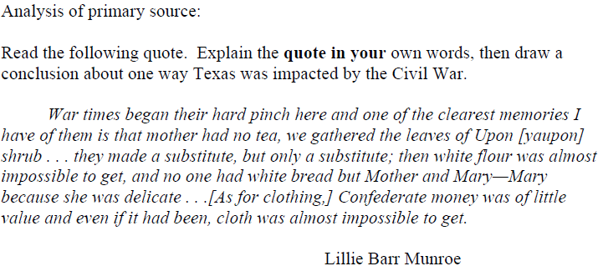
Warm Up

Slide 10
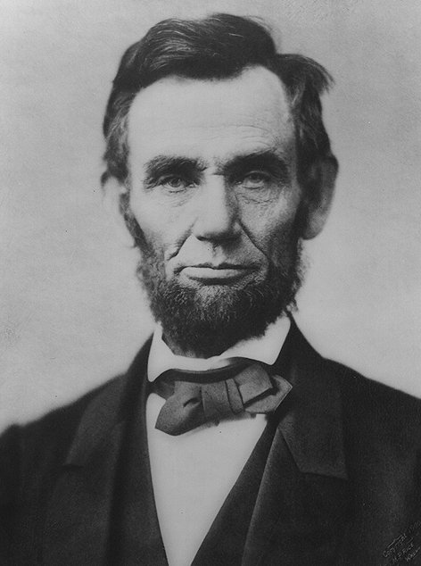
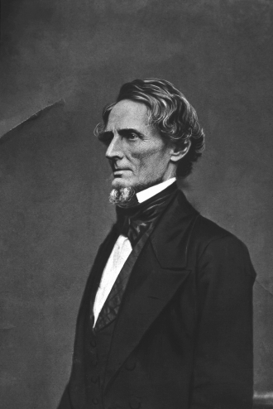
President of the United States of America
Abraham Lincoln
President of the Confederate States of America
Jefferson Davis

Slide 11
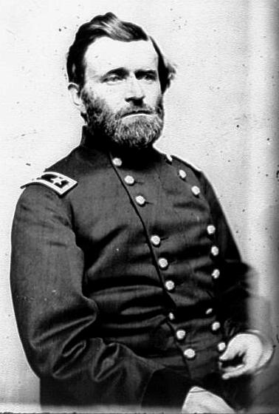
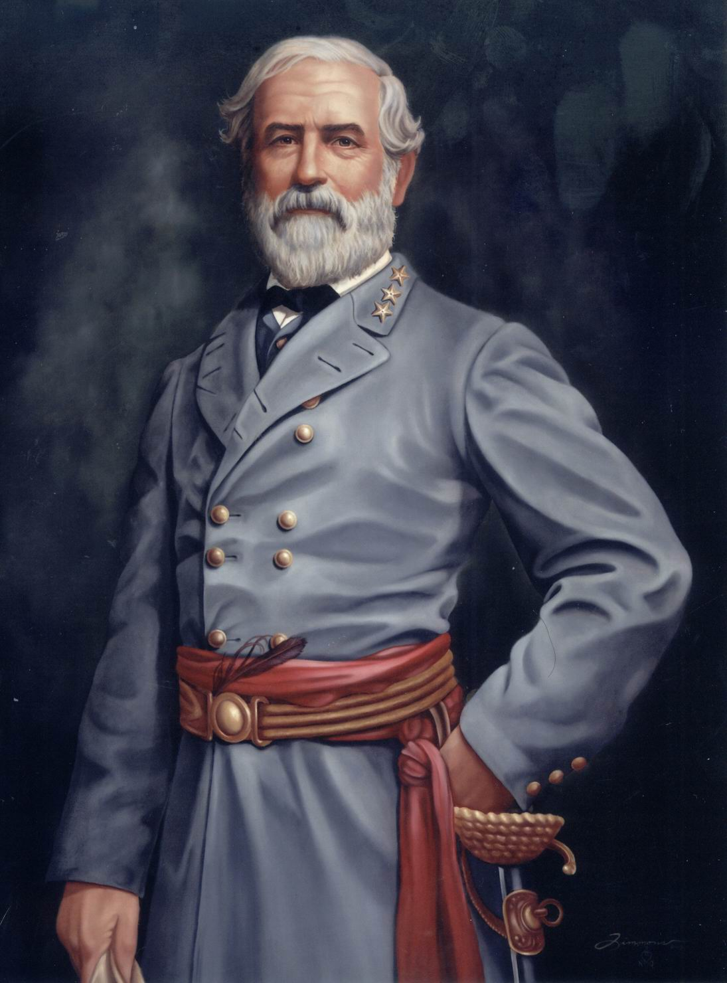
General of the Union
Ulysses S. Grant
General of the Confederacy
Robert E. Lee

Slide 12
Texans in the Civil War
ALBERT SIDNEY JOHNSTON
Second highest ranking general in the Confederate Army
Commanded Confederate troops in the Tennessee area
Killed at the Battle of Shiloh in April 1862
Notes:
ALBERT SIDNEY JOHNSTON
Second highest ranking general in the Confederate Army
Commanded Confederate troops in the Tennessee area
Killed at the Battle of Shiloh in April 1862
LAWRENCE SULLIVAN ROSS
Led Ross’s Brigade that fought in Georgia, Mississippi (including Vicksburg), and Tennessee
TERRY’S TEXAS RANGERS
Organized in Houston on September 9, 1861 with just over 1,000 men, most enlisting for the “duration of the war” and left Texas for Kentucky and Tennessee
Fought in more battles than any other cavalry regiment
Officially known as the 8th Texas Cavalry Regiment
HOOD’S TEXAS BRIGADE
Led by John Bell Hood
Fought in many battles in Virginia
Robert E. Lee called Hood’s men his “finest soldiers”
Created on October 22, 1861 and was a major part of the Army of Northern Virginia
Of the 5,353 men who enlisted in these regiments, only 617 survived to the surrender

Slide 13
Important People and Events of the Civil War
John Reagan
Served in the cabinet of Confederate President Jefferson Davis as Postmaster General

Slide 14
Important People and Events of the Civil War
Francis Lubbock
Governor of Texas in 1861
Assistant to Confederate President Jefferson Davis
John Magruder
Commanded Confederate forces in Texas
Recaptured Galveston

Slide 15
Important People and Events of the Civil War
Thomas Green
Led the troops that were on the steamboats converted to gunboats by General John B. Magruder, who commanded the Confederate forces in Texas

Slide 16
Copy the following chart into your journal. Causes of the Civil War
Social Having to do with people living in groups | Economic Related to the development, of material wealth | Political Concerned with or pertaining to government
Notes:
EXPLAIN: STUDENTS WILL EXPLAIN THE SOCIAL, ECONOMIC AND POLITICAL CAUSES OF THE CIVIL WAR.

Slide 17
Causes of the Civil War
Social | Economic | Political
1. SLAVERY South supported use of slave labor while North supported use of paid labor 2. CULTURE South was an aristocratic, planter society while the North was an industrialist society | 3. TARIFFS South supported low tariffs while North supported high tariffs to protect its manufacturers from foreign competition 4. ECONOMIC BASE South was dependent on the agriculture while the North was dependent on trade and industry | 5. STATES’ RIGHTS South supported state sovereignty (states deciding what was best for themselves) while north supported national sovereignty
Notes:
EXPLAIN ACTIVITY ANSWER KEY.

Slide 18
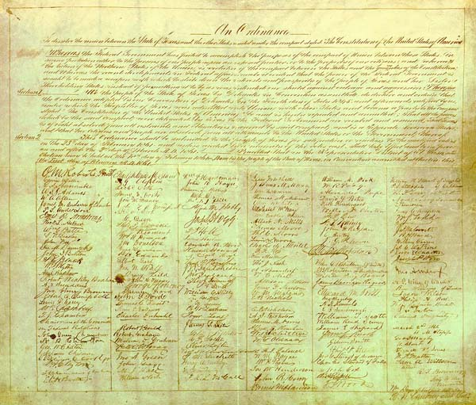
In its declaration of secession, Texas stated that it intended to go to war to preserve a southern way of life that made racial distinctions, in part, by maintaining blacks in a condition of servitude.

Slide 19
Many Texans Become Soldiers
Thousands of Texans like other Southerners joined the Confederate army immediately.
In April 1862, the Confederate Congress passed the Conscription Act which required men of a certain age to serve in the Confederate military
German Americans and many other European immigrants to Texas objected to fighting against the Union.

Slide 20
Most Texans Support the South
After the war began, most Texans who previously had been against secession now supported the Confederacy.
James W. Throckmorton, who had voted against secession, realized that he could not fight against Texas.
About 60,000 Texans joined the armed forces of the Confederacy.

Slide 21
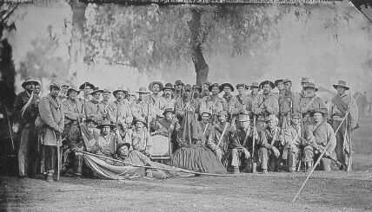
5TH TEXAS VOLUNTEER INFANTRY, CO. K

Slide 22
Some Texans Aid the Union
About 2,000 Texas Unionists, including 50 African-Americans, took up arms for the Union. Mexican-Americans served on both sides of the war.
Many Texas Unionists who did not want to fight on either side left Texas.

Slide 23
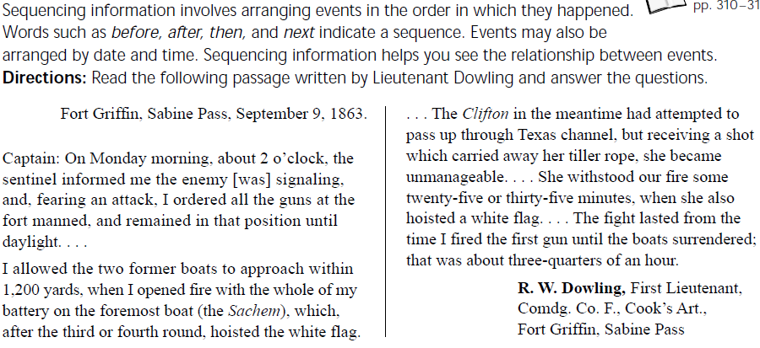
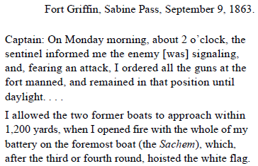
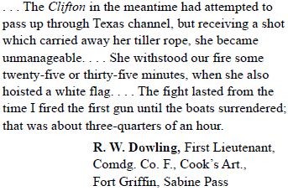

Slide 24
Major Battles of the Civil War

Slide 25
Study the charts that follow and decide: What were the Union Advantages? What were the Confederate Advantages?

Slide 26
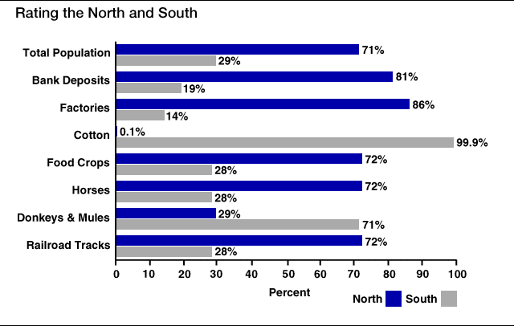
Rating the North & South - Population

Slide 27
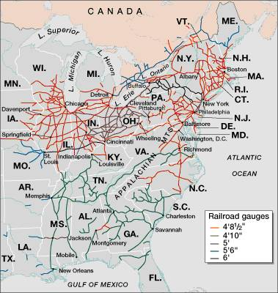
Railroad Lines in 1860

Slide 28
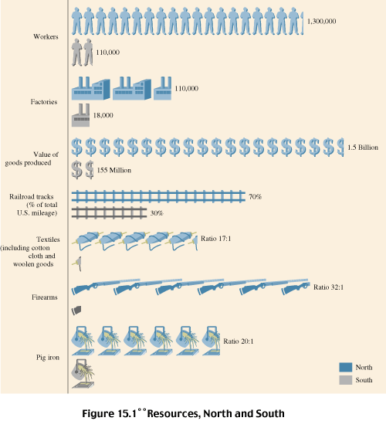
Industries & Workers: North & South

Slide 29
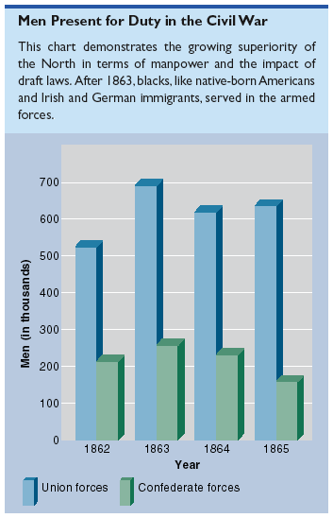
Soldiers Present for Duty in the Civil War

